Slide 1
Predicting NYC High School Graduation Rates
By Gloria Kwan
Link to Code

Slide 2
What factors impact a student’s chances of graduating high school in NYC?
School district
Ethnicity
Gender
Socioeconomic status

Slide 3
Dataset
From NYC Open Data
We have NYC high school graduation outcomes for the classes of 2005-2011 that include:
School name
Cohort year
Cohort category (ie. 4 year, 5 year, etc)
Ethnicity information
Total graduate percent of cohort

Slide 4
Hypothesis:
Your ethnicity has an impact of your high school graduation rate. Being a student of color decreases your chances of graduating high school, particularly African Americans and Hispanics.

Slide 5
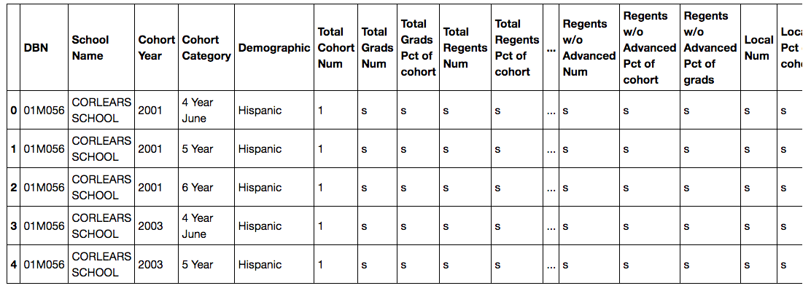
Cleaning the data
Selecting the columns I wanted in my dataset (Demographic, Total Grads Pct of cohort)
Renaming the columns to all lower case
Removing all the rows with N/A values (all rows with ‘s’)

Slide 6
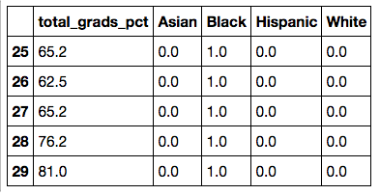
Cleaning the data
Removing the % sign from total_grads_pct and converting it to a numeric value
Converting demographic groups into dummy variables
Ended up with 14, 250 rows

Slide 7
Clean Dataset
N = 14,250
Asian: 1633
White: 1609
Black: 5547
Hispanic: 5461
A lot more data on the Black and Hispanic group

Slide 8
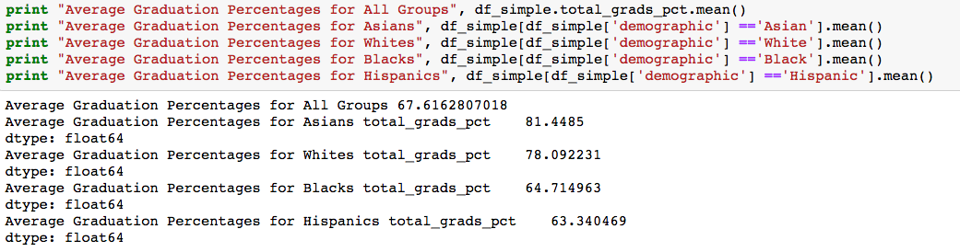
Comparing Average Graduation Rates
All groups: 68%
Asian: 81%
Black: 65%
Hispanic: 63%
White: 78%

Slide 9
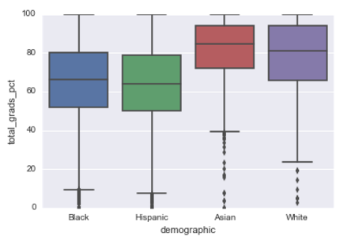
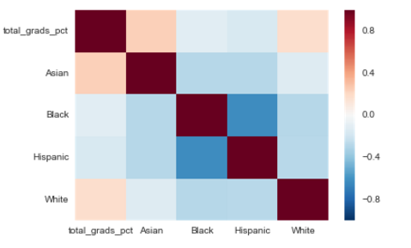
Exploratory Analysis

Slide 10
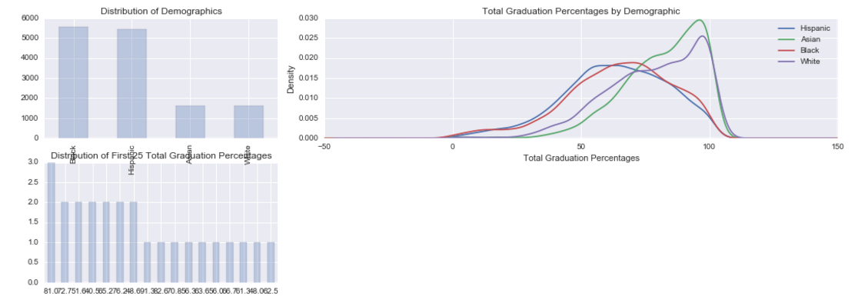
Exploratory Analysis

Slide 11
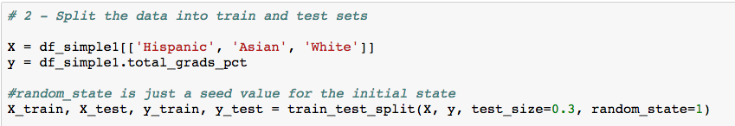
Train/test data

Slide 12
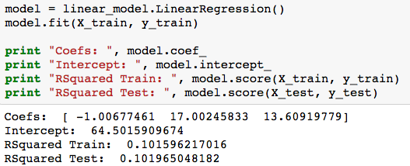
Linear Regression

Slide 13
Challenges
A lot more data points for the Hispanic and Black groups
Low r-squared
Wanted a bigger dataset that included other impacting factors (gender, school district, socioeconomic data)

Slide 14
Future Ideas
Using the average of total_grads_pct for each group instead of dropping the rows with N/A
Combine another dataset with gender, school district and socioeconomic data

